Slide 1
C-Rate
C rate is a relative measure of cell electrical current
It is the constant-current charge or discharge rate that the cell can sustain for one hour
E.g., A 20 Ah cell should be able to deliver 20 A ("IC") for 1 h or 2 A
("C/IO") for about 10 h (but the relationship is not strictly linear)

Slide 2
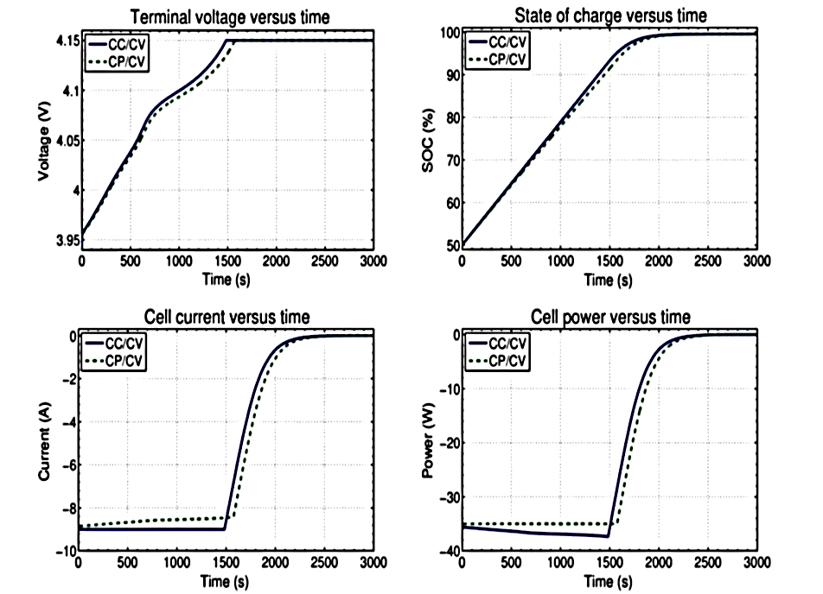

Slide 3
Energy and Power
A cell stores energy in electrochemical form, which it can later release to do work
The total energy storage capacity of a cell is roughly its nominal voltage multiplied by its nominal capacity (mWh, Wh, or kWh) E.g., The nominal energy storage capacity for a 3.7 V and 1.9 Ah Battery will be 3.7 x 1.9 7.03 Wh
The energy release rate is the cell's instantaneous power (mW, W, or kW)

